Slide 1
TDT4252
Modelling of Information Systems
Advanced Course
Sobah Abbas Petersen
Adjunct Associate Professor
sap@idi.ntnu.no
Lecture 15 – Enterprise Architecture: Gartner, FEA
TDT4252, Spring 2013

Slide 2
This Lecture
Enterprise Architectures continued: Gartner, FEA
  Based on lecture slides from Spring 2010, by Harald Rønneberg.
Requiered Reading:
  A16: Roger Sessions, A Comparison of the Top Four Enterprise-Architecture Methodologies, White Paper, ObjectWatch Inc. May 2007.
Additional reading:
  Federal Enterprise Architecture Framework, Version 1.1, September 1999, (http://www.cio.gov/documents/fedarch1.pdf)
  http://en.wikipedia.org/wiki/Federal_Enterprise_Architecture
  Cisco Systems, 2009. Federal Enterprise Architecture (FEA) and Network Services, White Paper, pages 1-6. (http://www.cisco.com/en/US/solutions/collateral/ns340/ns414/ns859/C11-542359-00_FEAnetsol.pdf)
Lecture 15 – Enterprise Architecture: Gartner, FEA
TDT4252, Spring 2013

Slide 3
What is Enterprise Architecture – recap
Lecture 15 – Enterprise Architecture: Gartner, FEA
TDT4252, Spring 2013

Slide 4


EA Bridges Strategy and Implementation
Architecture
Business architecture
Information architecture
Solution architecture
Technology architecture
Business Strategy
Implementation
Business drivers
Business goals
Business policy
Trend analysis
Business processes
Application systems
Tech infrastructure
Organizational structure
The bridge between strategy & implementation
Lecture 15 – Enterprise Architecture: Gartner, FEA
TDT4252, Spring 2013
Notes:
Harald Rønneberg
Fra ambisjon til handing!
Her ser vi også hva Gartner legger i begrepet business strategy.
Og vi ser at det ikke bare er fokus på implementasjon av IT!!!

Slide 5
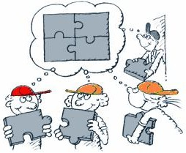
Alignment
Common understanding!
Lecture 15 – Enterprise Architecture: Gartner, FEA
TDT4252, Spring 2013
Notes:
Harald Rønneberg
Slik jeg ser det er dette et godt bilde på alignment. Alle kjenner sin bit og vet hvordan det hele henger sammen.
Det handler om felles forståelse!

Slide 6
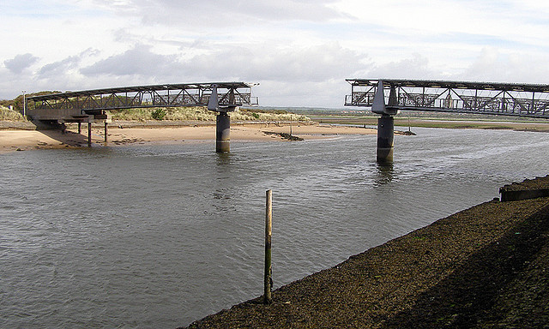



Example case: MEM-EA
Internal conflicts between the technical and and the business side.
  Business side saw IT as reducing business agility.
  IT side saw the business side as making impossible demands.
  Crisis!
Cath, CEO
Bret, Business Manager
Irma, CIO
Lecture 15 – Enterprise Architecture: Gartner, FEA
TDT4252, Spring 2013

Slide 7
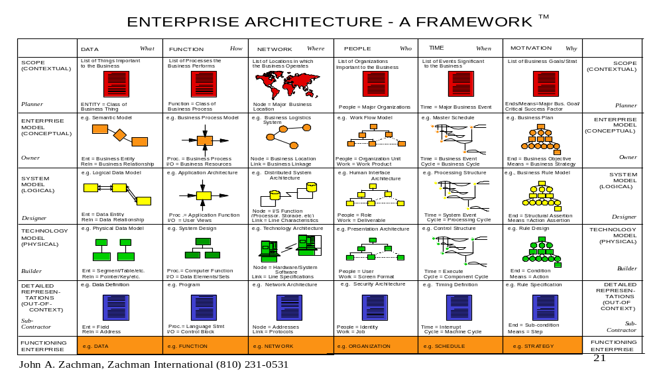
Zachman’s EA Framework - recap
Aspects
View
Viewpoints
Lecture 15 – Enterprise Architecture: Gartner, FEA
TDT4252, Spring 2013
Notes:
Harald Rønneberg
Radene viser detaljeringen
Kolonnene viser fokusområdene
Du kan selvsagt velge andre fokusområder og detaljering/nedbryting, men det var denne Zachman endte opp med.
Zachman er et kjent EA rammeverk med fokus på alt fra abstrakte og overordnede modeller og beskrivelser
til detaljerte og fysiske modeller og beskrivelser
Skal dette rammeverket følges 100%, får du mange detaljerte modeller og beskrivelser!
Hva er utfordringene med modeller og beskrivelser??? OPPDATERING!!

Slide 8
TOGAF – consists of
An Architectural Development Method (ADM)
Foundation Architecture
  A Technical Reference Model (TRM)
  A Standards Information Base (SIB)
  Building Blocks Information (BBIB)
Resource Base contains advice on:
  Architecture views, IT Governance, Business scenarios, Architecture patterns, etc.
Greenslade, 2000-2002
Lecture 15 – Enterprise Architecture: Gartner, FEA
TDT4252, Spring 2013

Slide 9
TOGAF – Framework or Process?
TOGAF describes itself as a Framework. But the most important part of it is the Architectural Development Method (ADM):
  ADM is a recipe for creating architecture.
TOGAF is an architectural process (Roger Sessions).
It complements Zachman’s Framework:
  Zachman tell you how to categorise artifacts; TOGAF provides a process for creating them.
Lecture 15 – Enterprise Architecture: Gartner, FEA
TDT4252, Spring 2013

Slide 10
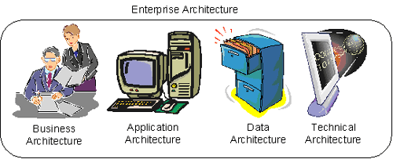
TOGAF’s Enterprise Architecture
Describes the processes the business uses to meet its goals.
Describes how specific applications are designed and how they interact with each other.
Describes how the enterprise datastores are organised and accessed.
Describes the hardware and software infrastructure that supports applications and their interactions.
Lecture 15 – Enterprise Architecture: Gartner, FEA
TDT4252, Spring 2013

Slide 11
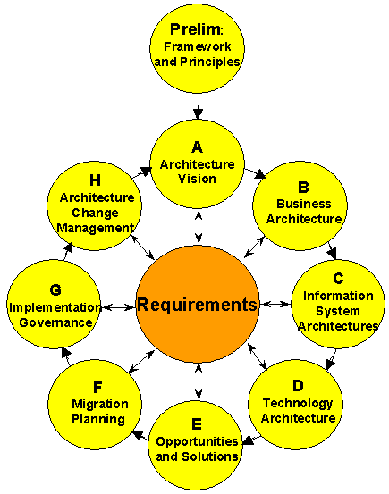
Architecture Development Cycle - ADM
Lecture 15 – Enterprise Architecture: Gartner, FEA
TDT4252, Spring 2013

Slide 12
TOGAF - benefits
TOGAF is flexible about the architecture that is generated – ”architecture agnostic” or vendor neutral.
Comprehensive process, from business requirements to applications to infrastructure.
The final architecture may be good, bad or indifferent.
TOGAF merely describes how to generate enterprise architecture, not necessarily how to generate a good one!
Lecture 15 – Enterprise Architecture: Gartner, FEA
TDT4252, Spring 2013

Slide 13
Gartner
A planning discipline for the enterprise that goes beyond technology choices:
  Driven by the strategic intent of the enterprise
  Holistic in breadth
  Designed to create a future-state “road map”
  Provides flexibility and adaptability for changing business, information, and solution needs => change enabler
  A bridge between strategy and implementation
Architecture
Strategy
Implementation
Lecture 15 – Enterprise Architecture: Gartner, FEA
TDT4252, Spring 2013

Slide 14
EA Bridges Strategy and Implementation
Architecture
Business architecture
Information architecture
Solution architecture
Technology architecture
Business Strategy
Implementation
Business drivers
Business goals
Business policy
Trend analysis
Business processes
Application systems
Tech infrastructure
Organizational structure
The bridge between strategy & implementation
Lecture 15 – Enterprise Architecture: Gartner, FEA
TDT4252, Spring 2013
Notes:
Harald Rønneberg
Fra ambisjon til handing!
Her ser vi også hva Gartner legger i begrepet business strategy.
Og vi ser at det ikke bare er fokus på implementasjon av IT!!!

Slide 15
From Strategy to Implementation
Planning and Strategy
  Focused on integration of business and IT planning
Enterprise Architecture
  Goal is to provide the road map for the enterprise
Program Management
  Primary agent for implementing enterprise transformation
Enterprise
Planning
and Strategy
Enterprise
Program
Management
Enterprise
Architecture
Lecture 15 – Enterprise Architecture: Gartner, FEA
TDT4252, Spring 2013

Slide 16
Gartner
The Gartner EA methodology is a ”practice” – Sessions.
It is an ongoing process of creating, maintaining, and especially, leveraging an enterprise architecture that gives the enterprise its vitality.
Lecture 15 – Enterprise Architecture: Gartner, FEA
TDT4252, Spring 2013

Slide 17



Gartner
EA is about creating a common understanding.
Bringing together 3 constituents: business owners, information specialists and technology implementers.
If we can unify these behind a common vision that drives the business value → success!
Business Owners
Information specialist
Common understanding
Technology Implementers
Lecture 15 – Enterprise Architecture: Gartner, FEA
TDT4252, Spring 2013

Slide 18
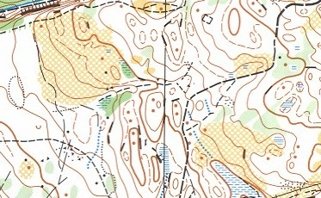
Gartner
x
Enterprise Architecture must start where an organisation is going, not where it is
  → focussed on destination.
Recommends that an organisation begins by telling the story of where its strategic direction is heading and what the business drivers are to which it’s responding.
Goal: everybody understands and shares a single vision.
As soon as an organisation has a single vision, the implications on the business, technical, information and solution architectures can be considered.
x
Lecture 15 – Enterprise Architecture: Gartner, FEA
TDT4252, Spring 2013

Slide 19
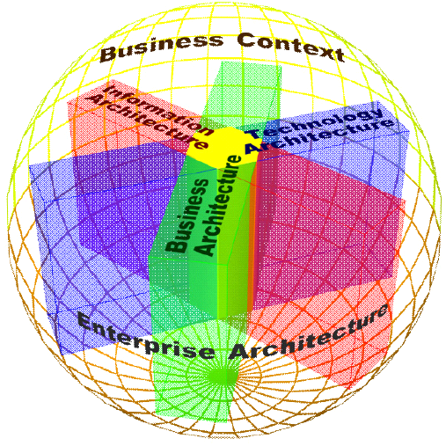
Gartner Enterprise Architecture Method
The two major facets of the Gartner EA method are:
Gartner Enterprise Architecture Process Model
Environmental Trends
Business Strategy
Organize Architecture Effort
Architecting
Develop
Requirements
Develop
Principles
Develop
Models
Future State Architecture
Closing
the Gap
Governing & Managing
Current State Architecture
Documenting
Gartner Enterprise Architecture Framework
Lecture 15 – Enterprise Architecture: Gartner, FEA
TDT4252, Spring 2013

Slide 20
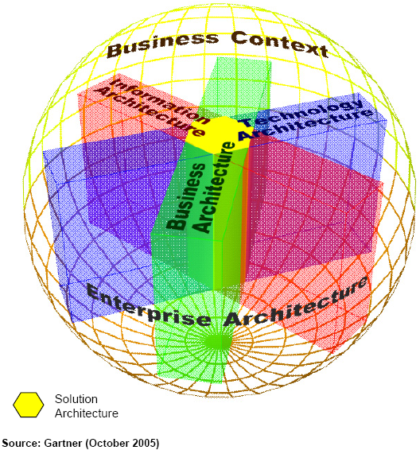
Gartner’s 4 Architectural Viewpoints
Three primary viewpoints:
  Business Architecture
  Information Architecture
  Technology Architecture
One meta-architecture viewpoint
  Solution Architecture
Solution Architecture Framework
  A framework for creating Solution Architectures
Lecture 15 – Enterprise Architecture: Gartner, FEA
TDT4252, Spring 2013

Slide 21
Gartner’s 4 Architectural Viewpoints
Business Architecture
  Defines and describes the current- and future- state models of business activities (processes, assets and organization structure)
Information Architecture
  Defines and describes the current- and future- state models of the information value chain, key information artifacts (concepts), information flows
Technology Architecture
  Defines and describes the current- and future- state models of the infrastructure and technology platforms required for the solution architecture and which enables rapid engineering, solutions development and technical innovation
Solution Architecture
  Combining and reconciling (integration) the loosely coupled and often conflicting viewpoints of the primary stakeholders into a unified architecture
  Having divided to conquer, we must reunite to rule
  SA is a consistent architectural description of a specific enterprise solution
  An intersection of viewpoints
Lecture 15 – Enterprise Architecture: Gartner, FEA
TDT4252, Spring 2013

Slide 22
Gartner Enterprise Architecture Process Model
Environmental Trends
Business Strategy
Organize Architecture Effort
Architecting
Develop
Requirements
Develop
Principles
Develop
Models
Future State Architecture
Closing
the Gap
Governing & Managing
Current State Architecture
Documenting
Lecture 15 – Enterprise Architecture: Gartner, FEA
TDT4252, Spring 2013
Notes:
Principles are guiding statements of position that communicate fundamental elements, truths, rules or qualities that must be exhibited by an enterprise to realize its goals.
Principles are used to guide consistent decision making.
Principles tend to be fairly timeless and static.

Slide 23
Organise Architecture Effort
Environmental Trends
Business Strategy
Organize Architecture Effort
Architecting
Develop
Requirements
Develop
Principles
Develop
Models
Future State Architecture
Closing
the Gap
Governing & Managing
Current State Architecture
Documenting
Lecture 15 – Enterprise Architecture: Gartner, FEA
TDT4252, Spring 2013

Slide 24
Organise Architecture Effort - Activities
State the goals
Scoping
Buy-in and commitment
Stakeholder analysis
Set time box
Establish EA team
Lecture 15 – Enterprise Architecture: Gartner, FEA
TDT4252, Spring 2013

Slide 25
Develop Requirements
Environmental Trends
Business Strategy
Organize Architecture Effort
Architecting
Develop
Requirements
Develop
Principles
Develop
Models
Future State Architecture
Closing
the Gap
Governing & Managing
Current State Architecture
Documenting
Lecture 15 – Enterprise Architecture: Gartner, FEA
TDT4252, Spring 2013

Slide 26

CRV - from strategy to business requirements
Cath, CEO
Greg, Gartner Consultant
Greg asks Cath to specify her visions in business (not technical terms).
The visions are prioritised.
Cath decides the highest priority is "MedAMore will reduce its purchasing costs by 10% by consolidating all regional purchasing into a central system".
CRV = Common Requirements Vision
Lecture 15 – Enterprise Architecture: Gartner, FEA
TDT4252, Spring 2013

Slide 27
What is CRV?
A process for capturing, discussing and documenting a shared common view of the strategic requirements driving the enterprise:
  Position on the impact of
  environmental trends to the enterprise
  Set of enterprise business strategies
  Set of common strategic
  requirements derived from
  enterprise business strategies
Environmental
Trends
Enterprise
Business
Strategies
Business
Change
Requirements
Business
Information
Requirements
Information
Technology
Requirements
Business
Solutions
Requirements
The CRV document is an articulation of what will drive the enterprise’s future state
Lecture 15 – Enterprise Architecture: Gartner, FEA
TDT4252, Spring 2013
Notes:
A CRV consists of various requirement types, including:
Business change requirements describe what is necessary to change about the business operations (processes, relationships, organization, structure, business model, etc.) to achieve business strategies
Business information requirements describe what the enterprise must do to leverage information to achieve business strategies
Information technology requirements describe what capabilities technology must provide to achieve business strategies
Business solution requirements describe the solutions required to satisfy the business, information, and technology requirements as integrated solutions to achieve business strategies

Slide 28
Develop Models
Environmental Trends
Business Strategy
Organize Architecture Effort
Architecting
Develop
Requirements
Develop
Principles
Develop
Models
Future State Architecture
Closing
the Gap
Governing & Managing
Current State Architecture
Documenting
Lecture 15 – Enterprise Architecture: Gartner, FEA
TDT4252, Spring 2013

Slide 29
Gartner’s 4 Architectural Viewpoints (1)
Business Architecture
  Defines and describes the future- state models of business activities (processes, assets and organization structure)
Information Architecture
  Defines and describes the future- state models of the information value chain, key information artifacts (concepts), information flows
Technology Architecture
  Defines and describes the future- state models of the infrastructure and technology platforms required for the solution architecture and which enables rapid engineering, solutions development and technical innovation
Greg, Gartner Consultant
Bret, Business Manager
Greg, Gartner Consultant
Irma, CIO
Lecture 15 – Enterprise Architecture: Gartner, FEA
TDT4252, Spring 2013

Slide 30
Gartner’s 4 Architectural Viewpoints (2)
Solution Architecture
  Combining and reconciling (integration) the loosely coupled and often conflicting viewpoints of the primary stakeholders into a unified architecture
  Having divided to conquer, we must reunite to rule
  SA is a consistent architectural description of a specific enterprise solution
  An intersection of viewpoints.
Lecture 15 – Enterprise Architecture: Gartner, FEA
TDT4252, Spring 2013

Slide 31
Current state and the gap
Environmental Trends
Business Strategy
Organize Architecture Effort
Architecting
Develop
Requirements
Develop
Principles
Develop
Models
Future State Architecture
Closing
the Gap
Governing & Managing
Current State Architecture
Documenting
Lecture 15 – Enterprise Architecture: Gartner, FEA
TDT4252, Spring 2013

Slide 32
Governing and Managing
Environmental Trends
Business Strategy
Organize Architecture Effort
Architecting
Develop
Requirements
Develop
Principles
Develop
Models
Future State Architecture
Closing
the Gap
Governing & Managing
Current State Architecture
Documenting
Lecture 15 – Enterprise Architecture: Gartner, FEA
TDT4252, Spring 2013

Slide 33
Gartner- benefits
Process completeness – the methodology fully guides you through a step-by-step process for creating EA.
Practical guidance.
Business focus.
Provides a methodology that can support governance.
Does not provide a complete taxonomy.
Not much information available about it.
Lecture 15 – Enterprise Architecture: Gartner, FEA
TDT4252, Spring 2013

Slide 34
What is FEAF?
FEAF (Federal Enterprise Architecture Framework) provides an organised structure and a collection of common terms by which Federal segments can integrate their respective architectures into the FEA (Federal Enterprise Architecture).
FEA is a strategic information asset base that defines the business, information necessary to operate the business, technology necessary to support the business operations and transitional processes for implementing new technologies in response to the changing needs of the business.
Lecture 15 – Enterprise Architecture: Gartner, FEA
TDT4252, Spring 2013

Slide 35
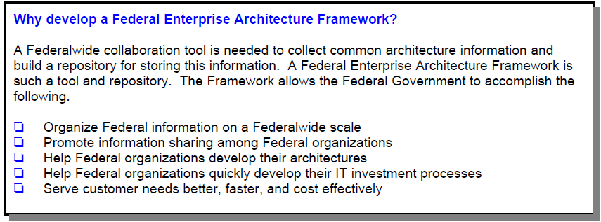
Why FEAF?
Lecture 15 – Enterprise Architecture: Gartner, FEA
TDT4252, Spring 2013

Slide 36
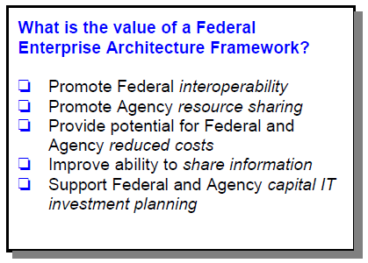
Value of FEAF
Lecture 15 – Enterprise Architecture: Gartner, FEA
TDT4252, Spring 2013

Slide 37
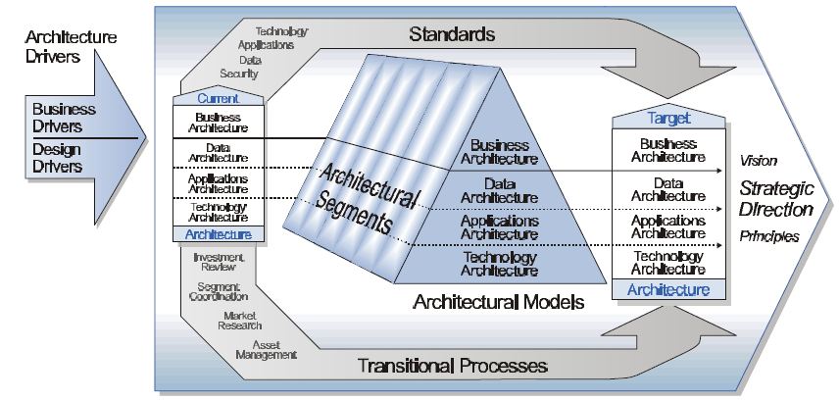
FEAF Components (1)
Refer to all standards (some of which may be mandatory), guidelines and best practices.
External stimuli or change agents for the enterprise architecture.
Defines the ”as-is” enterprise architecture. Consists of 2 parts: current business and design architectures (i.e. data, applications and technology).
Defines the ”to-be” enterprise architecture. Consists of 2 parts: current business and design architectures (i.e. data, applications and technology).
Lecture 15 – Enterprise Architecture: Gartner, FEA
TDT4252, Spring 2013
Notes:
Reference page 6, FEAF Version 1.1, 1999, CIO.

Slide 38
FEAF Components (2)
Consists of focused architecture efforts on major cross-cutting business areas and program areas.
Guides the development of the target architecture and consists of a vision, principles, goals and objectives.
Defines the business and design models that compromise the segments of the enterprise descriptions.
Supports the migration from the current to the target architecture. This includes migration planning, investment planning, engineering change control, etc.
Lecture 15 – Enterprise Architecture: Gartner, FEA
TDT4252, Spring 2013
Notes:
Reference page 6, FEAF Version 1.1, 1999, CIO.

Slide 39
FEAF - Segments
FEAF allows critical parts of the overall Federal Enterprise, called architectural segments, to be developed individually, while integrating these segments into the larger Enterprise Architecture.
Lecture 15 – Enterprise Architecture: Gartner, FEA
TDT4252, Spring 2013

Slide 40
FEA – Federal Enterprise Architecture
FEA is the latest attempt by the US federal government to unite its agencies and functions in a single common and ubiquitous enterprise architecture.
FEA is the most complete methodology. It has a:
  A comprehensive taxonomy, like Zachman’s framework.
  An architectural process, like TOGAF.
FEA can be viewed as either a methodology for creating an enterprise architecture or the result of applying that process to a particular enterprise.
FEA includes everything necessary for building an enterprise architecture.
Lecture 15 – Enterprise Architecture: Gartner, FEA
TDT4252, Spring 2013

Slide 41
FEA – Reference Models
The goal of the reference models is to provide standardised terms and definitions for the domain of enterprise architecture and thereby facilitate collaboration and sharing across the federal government.
It’s all about establishing a common language.
Collectively, the reference models comprise a framework for describing important elements of the FEA in a common and consistent way.
Lecture 15 – Enterprise Architecture: Gartner, FEA
TDT4252, Spring 2013

Slide 42
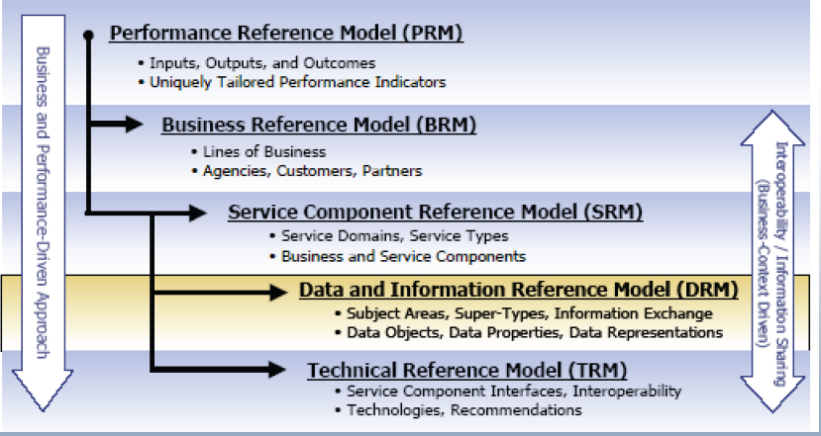
FEA – Reference Models
FEA consists of 5 reference models:
Lecture 15 – Enterprise Architecture: Gartner, FEA
TDT4252, Spring 2013

Slide 43
FEA – Reference Models: descriptions
Business Reference Model (BRM):
  Gives a business view of the various business functions.
Service Components Reference Model (CRM):
  Gives a more IT view of systems that can support business functionality.
Technical Reference Model (TRM):
  Defines the various technologies and standards that can be used in building ITsystems.
Data Reference Model (DRM):
  Defines standard ways of describing data.
Performance Reference Model (PRM):
  Defines standard ways of describing the value delivered by enterprise architecture.
Lecture 15 – Enterprise Architecture: Gartner, FEA
TDT4252, Spring 2013

Slide 44
FEA – Segment architecture approach
FEA perspective on EA: an enterprise is built of segments.
A segment is a major line-of-business functionality, such as human resources.
Although segments function at the political level (the agency), they are defined at the enterprise level (government).
Segments are defined globally to facilitate reuse across the the different enterrpises.
Lecture 15 – Enterprise Architecture: Gartner, FEA
TDT4252, Spring 2013

Slide 45
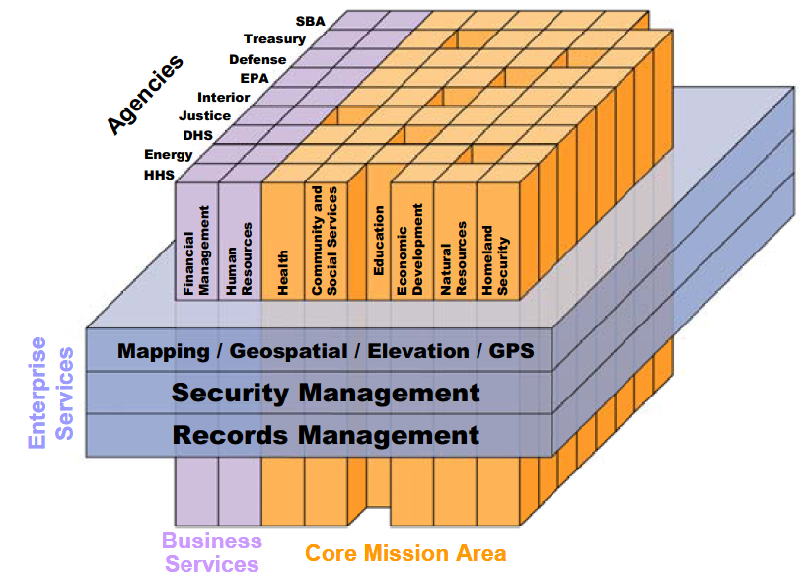
FEA – Segment Map
Segments (vertical columns): spans a single organisation, used by multiple segments.
Enterprise Services: have a scope across the entire enterprise.
Lecture 15 – Enterprise Architecture: Gartner, FEA
TDT4252, Spring 2013

Slide 46
FEA Process (1)
FEA Process is primarily focussed on creating a segment architecture for a subset of the overall enterprise.
Segment architecture development process:
  Step 1: Architectural analysis.
  Step 2: Architectural definition.
  Step 3: Investment and funding strategy.
  Step 4: Program management plan and execute projects.
Lecture 15 – Enterprise Architecture: Gartner, FEA
TDT4252, Spring 2013

Slide 47
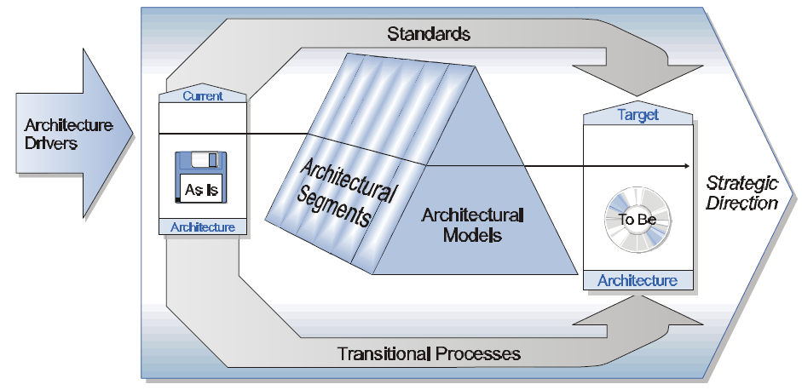
FEA Process, Level I
High level
Lecture 15 – Enterprise Architecture: Gartner, FEA
TDT4252, Spring 2013

Slide 48
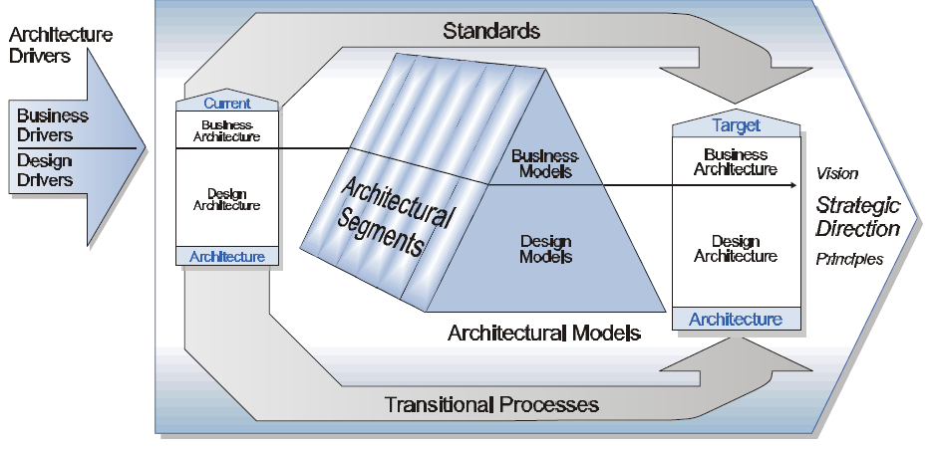
FEA Process – Level II
More detail – the business and design pieces of the architecture and how they are related.
Lecture 15 – Enterprise Architecture: Gartner, FEA
TDT4252, Spring 2013

Slide 49
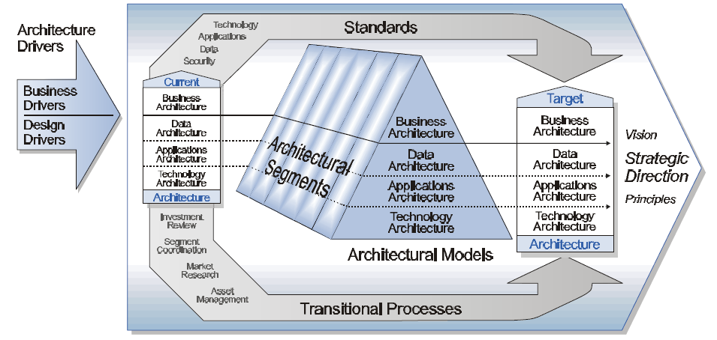
FEA Process – Level III
Expand the design pieces of the framework to show the 3 design architectures: data, application and technology.
Lecture 15 – Enterprise Architecture: Gartner, FEA
TDT4252, Spring 2013

Slide 50
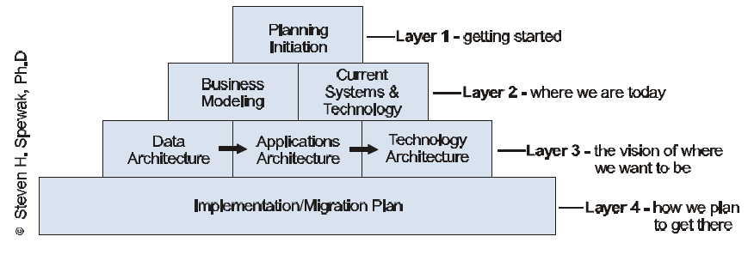
FEA Process – Level IV
Identifies the kinds of models that describe the business architecture and the three design architectures ( data, applications and technology).
It also defines Enterprise Architecture Planning (EAP).
EAP focuses on defining what data, applications and technology architectures are appropriate for and support the overall enterprise.
EAP
Lecture 15 – Enterprise Architecture: Gartner, FEA
TDT4252, Spring 2013

Slide 51
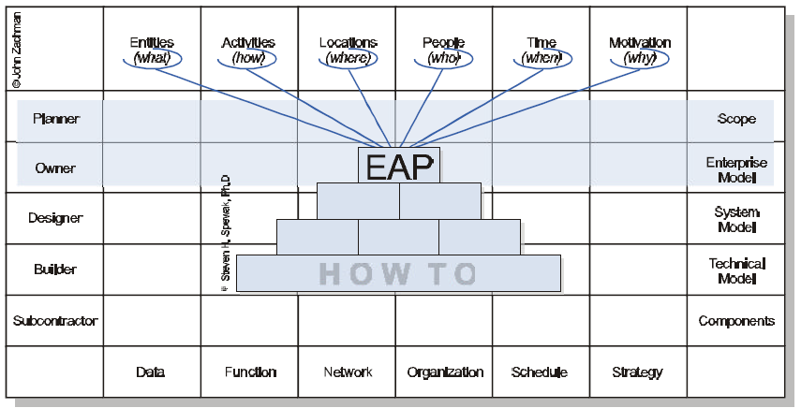
EAP and Zachman
Lecture 15 – Enterprise Architecture: Gartner, FEA
TDT4252, Spring 2013

Slide 52
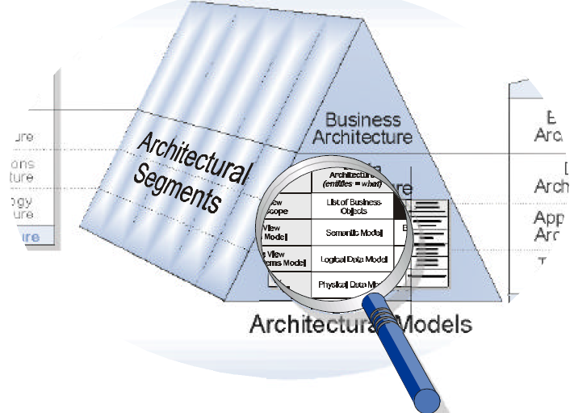
FEA Models
How the models (according to Zachman’s framework) relate to FEA.
Lecture 15 – Enterprise Architecture: Gartner, FEA
TDT4252, Spring 2013

Slide 53

Discussion and example case
FEA and FEAF were originally designed for the federal US government.
Can FEA be applied to private enterprises?
Cath, CEO
Fred, FEA Consultant
Lecture 15 – Enterprise Architecture: Gartner, FEA
TDT4252, Spring 2013

Slide 54
FEA and MAM-EA
Fred, FEA Consultant
Build enthusiasm for MAM-EA.
Build a governance structure – FEA Project Management Office (PMO).
Create reference models (PRM, BRM, TRM, DRM, SRM) that can be used by all the organisations across MedAMore.
Create a desription of a reference architecture as it applies to MedAMore.
Test drive the segment architecture process.
Analyse and prioritise the segments.
Enterprise Architecture program assessment.
Restart process with a new segment.
Lecture 15 – Enterprise Architecture: Gartner, FEA
TDT4252, Spring 2013

Slide 55
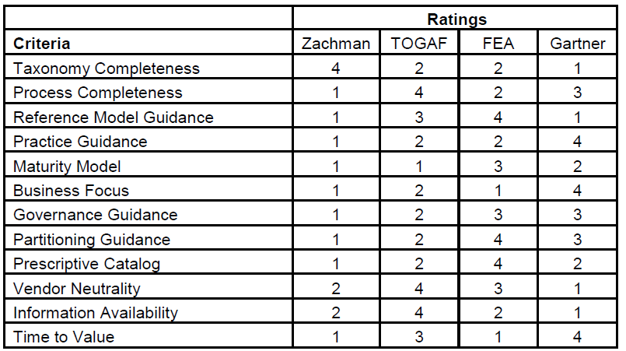
Comparing EA Approaches
Lecture 15 – Enterprise Architecture: Gartner, FEA
TDT4252, Spring 2013

Slide 56
How can we choose an EA methodology?
Go through the criteria for comparing and evaluating EA methodologies, that are important for your organisation.
Rate the methodologies.
What you may find out is that you need a blended approach, in which you create your own enterprise architecture, taking parts of different methodologies that provide the highest value for your specific needs.
Lecture 15 – Enterprise Architecture: Gartner, FEA
TDT4252, Spring 2013

Slide 57
Discussions
x
x
Several different EA Methodologies, quite different from one another.
Some of the methodologies complement one another, e.g. Zachman framework provides a taxonomy while TOGAF provides a process.
Enterprise architecture is a path, not a destination.
Main goal: to bring alignment to the business side and the technology side.
Lecture 15 – Enterprise Architecture: Gartner, FEA
TDT4252, Spring 2013

Slide 58
Summary
We have looked at several Enterprise Architecture methodologies: Zachman, TOGAF, Gartner and FEA.
We have compared them by using a case study.
Can we see similarities and differences between EA and Enterprise Modelling as we have discussed in this course?
Lecture 15 – Enterprise Architecture: Gartner, FEA
TDT4252, Spring 2013

Slide 59
What next?
Summary Lecture?
Lecture 15 – Enterprise Architecture: Gartner, FEA
TDT4252, Spring 2013

